Slide 1
Splunk Searches
SIEM Day 2
1

Slide 2

Class Objectives
By the end of today’s class, you will be able to:
Explore and select Splunk add-ons and apps based on project needs.
Upload logs into a Splunk repository.
Create complex SPL queries to analyze specific security situations.
2

Slide 3

Today we will use a powerful big data tool offered by the software company Splunk.
3

Slide 4

Introducing Splunk
Splunk is...
a software tool that searches, analyzes, and monitors big data with an easy-to-use interface.
Splunk can...
capture large amounts of incoming data, and create visualizations, reports, and alerts.
Splunk has...
a base product designed to conduct basic tasks such as searching and reporting.
4

Slide 5
Introducing Splunk
While our focus this week is on Splunk’s benefits to infosec industry, Splunk is useful for a variety of industries, such as:
01
02
03
Finance
Utilities
Healthcare
5

Slide 6

For example, financial organizations can use Splunk to analyze mortgage rates to determine future rate changes.
Finance
6
Notes:
shutterstock_376748761

Slide 7

For example, gas companies can use Splunk to monitor customer use levels.
Utilities
7
Notes:
shutterstock_1052081066

Slide 8

For example, medical researchers can use Splunk to create reports and metrics for analyzing successes of medical trials.
Healthcare
8
Notes:
shutterstock_1027449325

Slide 9

Apps, Add-Ons, and Suites
Splunk can be used for these industry-specific tasks by adding the following to the base product: Splunk apps, Splunk add-ons, and Splunk suites.
(splunk.com)
9

Slide 10
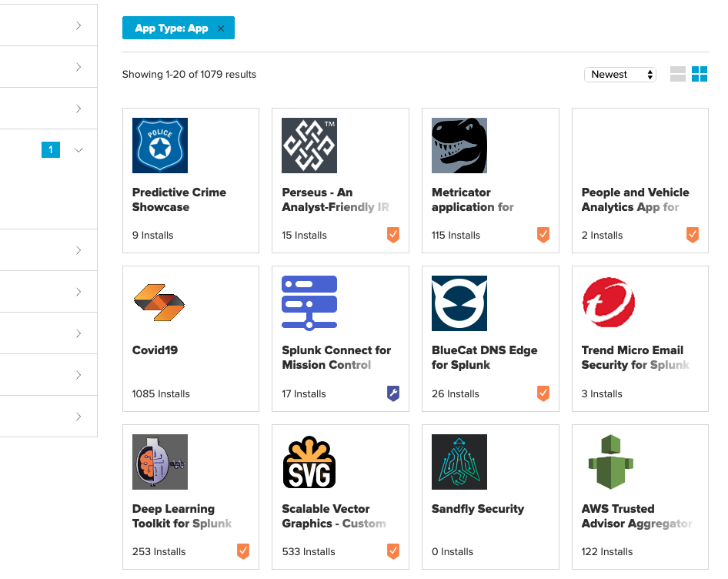
are applications that users can add to their Splunk base product. Apps have custom searches and features, and their own interface.
Splunk Apps
(Source)
(splunkbase.splunk.com)
10

Slide 11
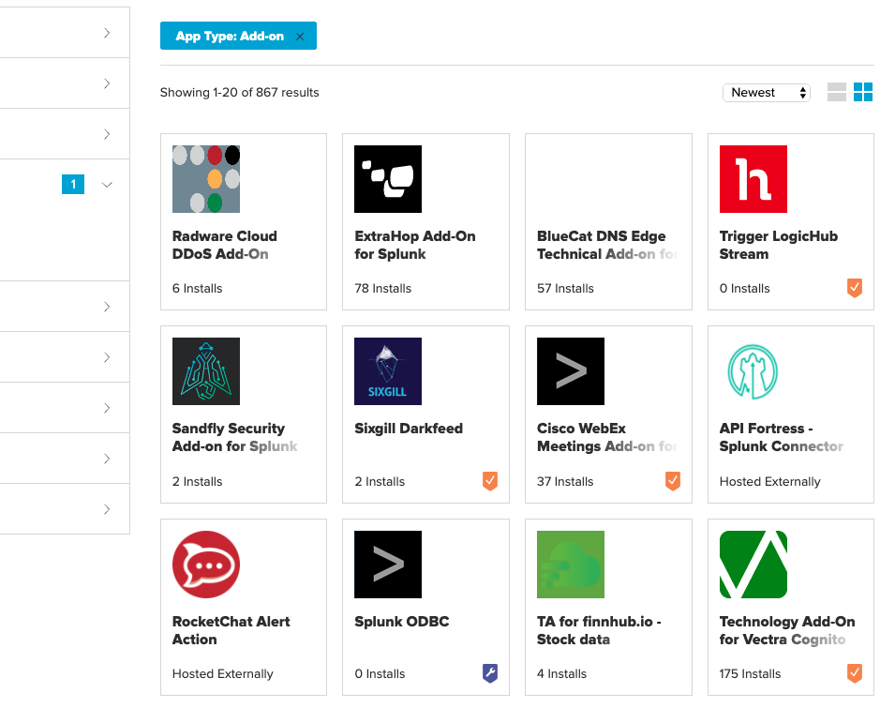
are smaller components that provide additional functionality, without their own interface.
Splunk Add-ons
(Source)
(splunkbase.splunk.com)
11

Slide 12
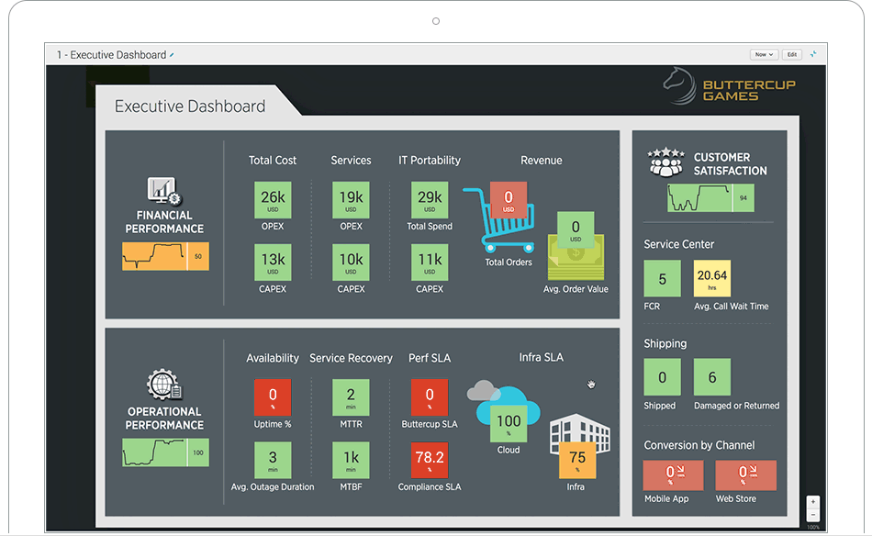
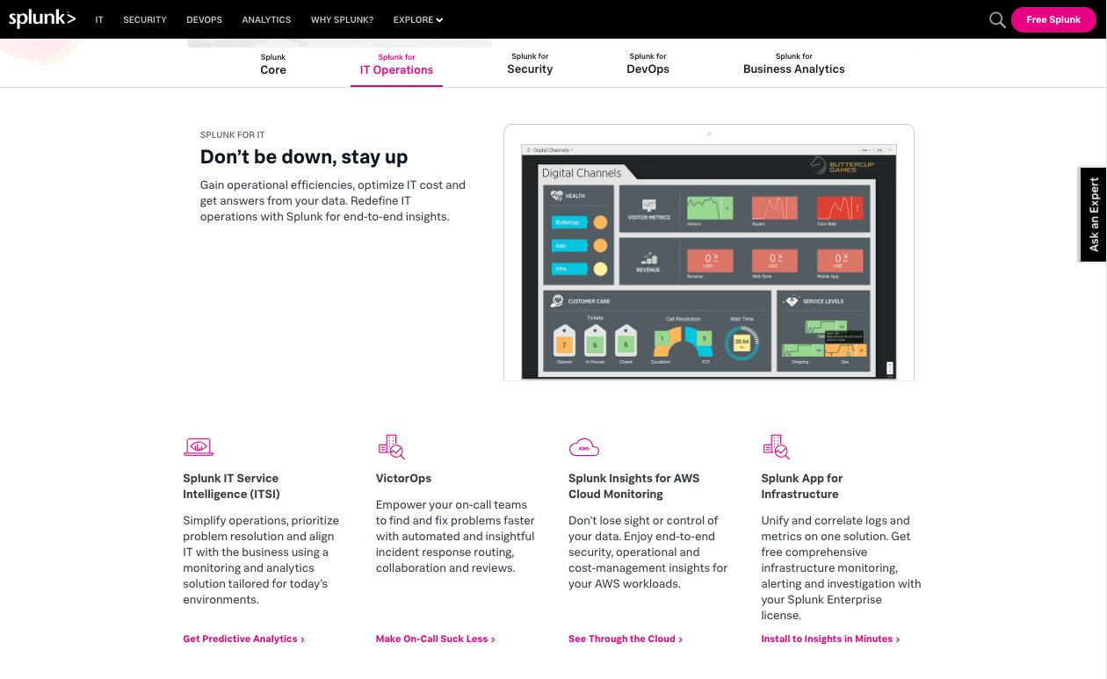
are collections of apps with a single focus, such as an industry or technology.
Splunk Suites
(Source)
12

Slide 13
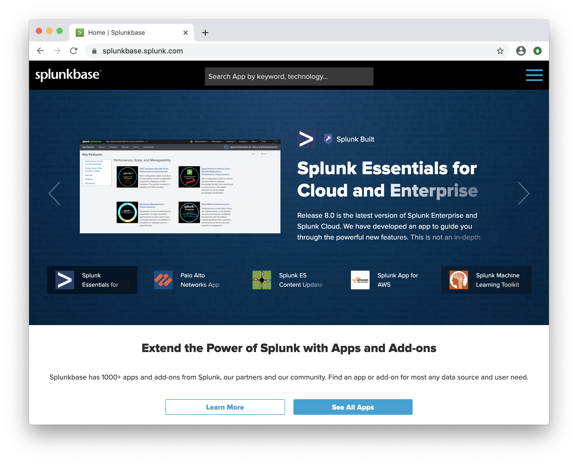

Splunk Add-ons and Apps
We will explore various Splunk apps and add-ons with the following scenario:
Your manager has notified you that your organization has purchased a web application filter by the vendor F5.
Your manager would like you to find the appropriate Splunk app to assist with monitoring this product.
(splunkbase.splunk.com)
13

Slide 14
Splunk Apps and Add-ons
14

Slide 15
Activity: Splunk Features
In this activity, you will analyze add-ons and apps to determine which will work with your security products.
7 Minutes
15

Slide 16
16

Slide 17
Tour of Splunk
17

Slide 18

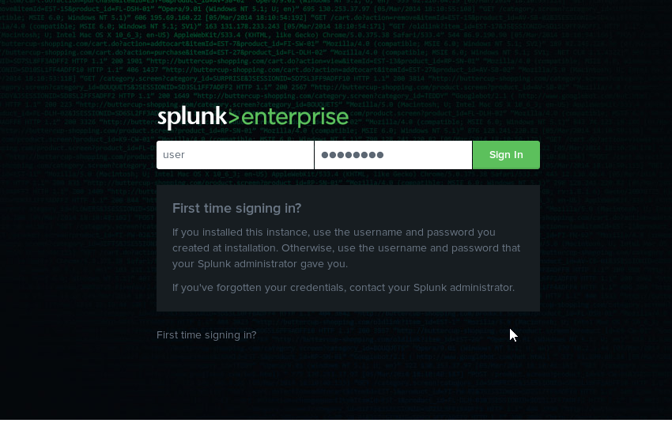
Splunk Setup
The best way to learn how to use the Splunk product is to dive right in and start using the application.
18
Notes:
shutterstock_1148076149

Slide 19

In the following guided tour, we’ll explore the Splunk setup, interface, and features.
19

Slide 20
Splunk Tour
20

Slide 21

Adding Data
To use the various search capabilities of Splunk, we need to first add the data to search against.
01
Indexer
02
Search head
When Splunk receives incoming data, it transforms the incoming data into events.
Splunk adds these events into repositories called indexes.
Indexers are used to add events to indexes and search through the data.
The search head is Splunk’s GUI that we use to conduct searches.
It manages search requests to the indexer and provides the search results back to the user.
21

Slide 22
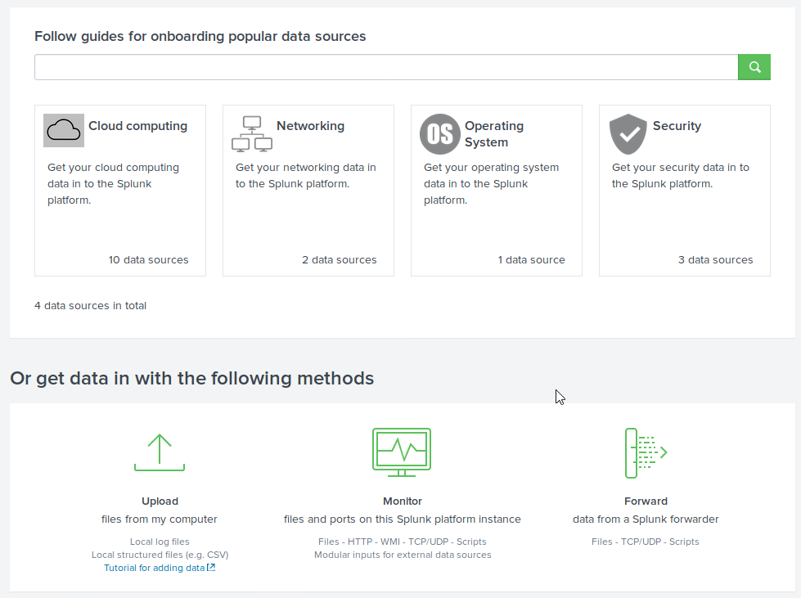
Searching in Splunk
In order to add data to Splunk on the Add Data page, we use one of the following paths:
From the Welcome page, go to Explore Splunk Enterprise and select Add Data.
From within the Search and Reporting app, select Settings > Add Data.
22

Slide 23
Adding Data
01
Add Data by Data Source
02
Adding Data by Method
We can upload data based on the source.
For example, a Splunk user may want to add Palo Alto Firewall logs into Splunk.
The Palo Alto option under Networking is an example of a data type.
Based on the option selected, an add-on may be provided or settings may be configured.
Or we can use one of these three methods to add data:
Monitor
Forward
Upload
23

Slide 24
Add Data Methods
Adding data by method allows you to add data by one of the following methods:
01
02
03
Monitor: Monitor logs from a system, device, or application that Splunk has direct access to.
Forward: Install a program called a forwarder on the system from which logs are collected.
Upload: Manually upload logs directly into your Splunk repository.
This is commonly used by businesses to monitor their production environment.
Forwarders forward logs from a device into the Splunk system.
We will primarily focus on this process during class.
24

Slide 25
Uploading Data into Splunk
In this demonstration, we will use the following scenario to upload data into Splunk:
Our manager reported suspicious login activity on our Linux servers.
We’ve been provided the login activity from the servers.
We must upload the activity data into Splunk so it can be analyzed.
25

Slide 26
Uploading Data Into Splunk
26

Slide 27
Activity: Uploading Data Into Splunk
In this activity, you will upload several log files that will be used later to analyze security events.
7 Minutes
27

Slide 28
28

Slide 29

29
Notes:
Image source: AdobeStock_56885471
Break

Slide 30
Searching with Splunk
30

Slide 31
Searching in Splunk allows users to query uploaded and monitored data.
Splunk queries can be customized to look only for specific data or to manipulate how the data is displayed.
31

Slide 32
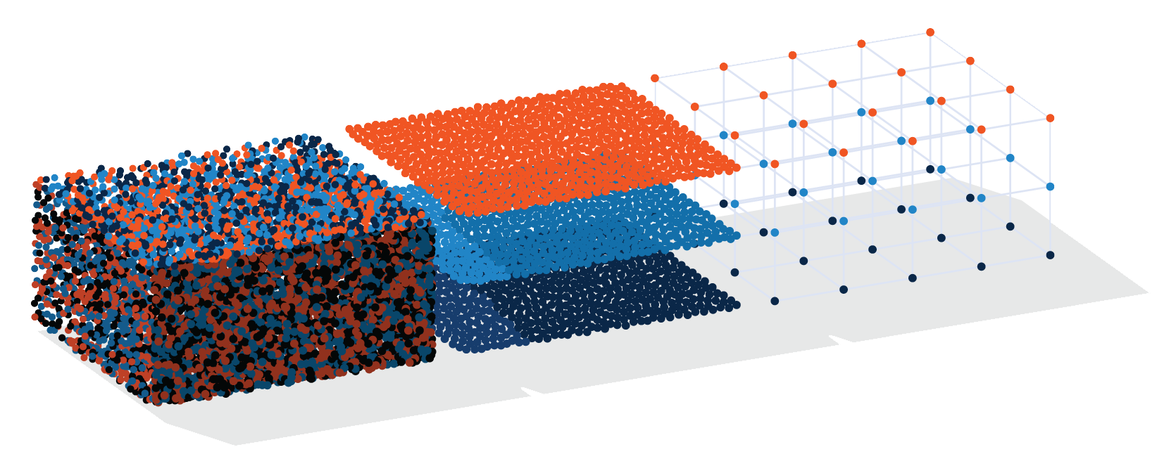
Searching in Splunk
We can use Splunk queries to find specific, helpful information about a security event.
For example
Determine the primary IP that is attacking during a DDOS attack.
Determine the user ID being used in a brute force attack.
Notes:
Shutterstock_572923834 earth AdobeStock_96904257

Slide 33
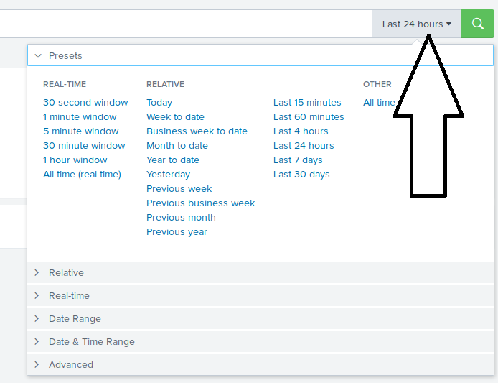
Searching Splunk
Splunk searching is almost always a time-based search.
All events have associated timestamps. To search for events, we must designate a time range or real-time period.
01
Real-time search
Returns a window of real-time data as it is happening and continues to update as the events occur.
02
Relative search
Returns data by date, date range, time, or time range. Results won’t change, even if more events occur.
03
All time search
Returns all available data based on the search.
33

Slide 34
Splunk queries are designed using a coding language called Splunk processing language (SPL).
34
Notes:
Image source: shutterstock_1083618569

Slide 35
Key-Value Pairs
Key-value pairs are the most common method used to search for data.
For example:
If you want to find a user named jonathan in your search results, you would design the following search:
user=jonathan
user=
is the key
jonathan
is the value
user=jonathan is the key-value pair
35

Slide 36
Wildcards
Similar to other programming languages, SPL uses wildcards. When used with the wildcard symbol (*) the search results return the search term followed by any character or string in place of the wildcard symbol.
For example:
user=mary* would return:
mary ann
user=mary*
mary beth
mary belle
36

Slide 37
Boolean Expressions
SPL uses the boolean expressions AND, OR, and NOT to assist in searching for specific data.
Expression | Use | Example
AND | Combines two key-value searches. | user=jonathan AND activity=login
OR | Looks for multiple instances of a key-value pair. | user=jonathan OR user=beth
NOT | Excludes certain values from search results. | user=jonathan NOT activity=logout
37

Slide 38
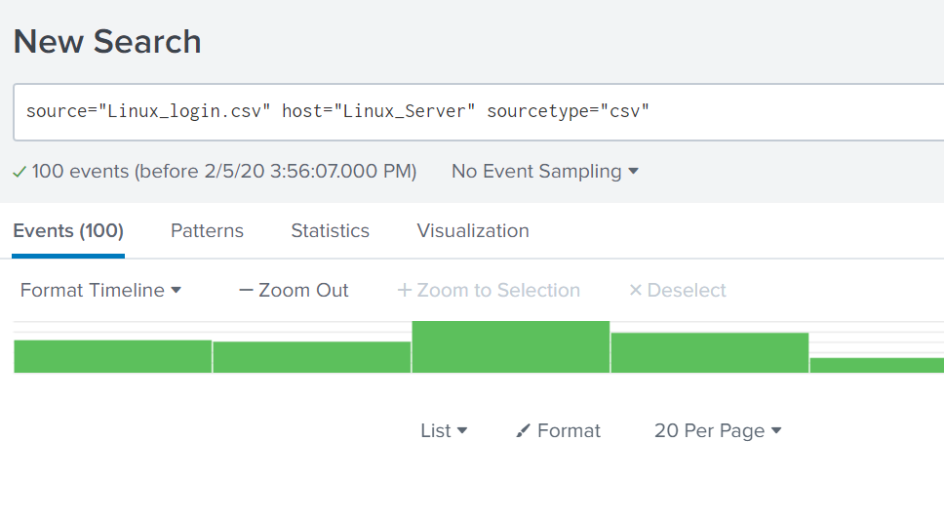
Search Demonstration
In the next demonstration, we will use the following scenario:
Your manager reported some suspicious login activity on your Linux servers.
They would like you to create a query to look at these login activities, specifically for logins coming from the source IP of 10.11.36.17.
They believe this IP is from a machine infected with malware.
38

Slide 39
Searching
39

Slide 40
Activity: SPL Search
In this activity, you must design SPL searches to run against the vulnerability scanning log file, nessus.txt.
7 Minutes
40

Slide 41
41

Slide 42

So far, we’ve been manually typing out the keys and values for our SPL queries.
The more complex the queries become, the more time-consuming this task will be.
(Source)
42
42

Slide 43
Keys and values may vary depending on server and application.
43
Notes:
Image source: shutterstock_1083618569

Slide 44
Complexities of SPL Queries
For example, if we need to find users that logged into a machine:
The might be:
The might be:
key
value
Activity
Login
Event_type
Logon
User_activity
Logged In
44

Slide 45
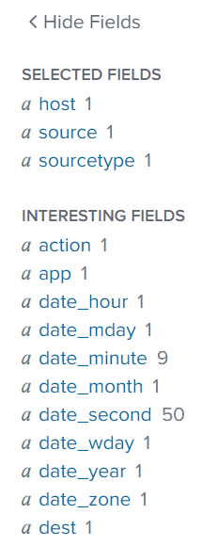
Search Fields
When files are uploaded and parsed, the data is separated into fields, as shown on the left side of Splunk’s search page.
Fields are divided into:
Selected fields
that appear in every log event.
Interesting fields
that appear in at least 20% of log events.
45

Slide 46
Creating Queries by Selecting Fields
46

Slide 47
Activity: Searching Fields with Splunk
In this activity, you will create complex SPL queries by selecting fields in your Splunk search.
7 Minutes
47

Slide 48
48

Slide 49

SPL Piping
We can add piping to our SPL queries to modify or adjust the display of the results, or to create custom reports.
source="Linux_login.csv" host="Linux_Server__" sourcetype="csv" | head 20 | sort src_ip
SPL piping uses the | symbol in the search queries.
Piping works in Splunk as it does in Linux. The data is modified from left to right as it flows through the pipeline.
49

Slide 50
SPL Piping
50

Slide 51
Activity: Advanced Searches with Piping
In this activity, you will run several advanced searches to find out if a specific user is being targeted by an attacker.
7 Minutes
51

Slide 52
52

